Slide 1





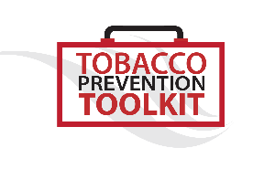
Risks of E-Cigarette and Vape Pen Use
Although the overwhelming majority of young people do not use e-cigarettes, the recent increase in use among adolescents is concerning to health professionals.
Nicotine use in early adolescence causes changes in the brain that make life-long addiction much more likely for young e-cig/vape users.
Ear, eye and throat irritation is common among e-cigarette/vape pen users.
The aerosols produced by the chemicals in e-juice, enter into the user’s lungs unfiltered and leave chemical residue behind.
Nicotine is known to have effects on the cardiovascular system. Some recent studies show that acute use of e-cigarette impaired flow-mediated dilation, this suggests that e-cigarettes can lead to cardiovascular diseases.
Recent studies show that e-cigarette/vape pen use is associated with the use of other tobacco products that are known to cause further health issues, including cancer and heart disease.
Many people incorrectly believe that these devices produce a water vapor when in fact they create aerosols that contain harmful chemicals, and ultra-fine particles that are inhaled into the lungs and out into the environment, making them harmful to the user and others nearby.
These devices are still very new so many of the long-term health consequences of their use is still not known. Even still, the mounting evidence shows that these devices are not harmless.

